Slide 1
Project Title: Water Quality Monitoring System
Team ID:EPICSA001
Team Members’ Details
Sl.No | Student ID | Student Name | Section | Contact | Email
1. | 2310040049 | D.VIJAYA NAVYA SRI | S2 | 99087 73156 | 2310040049@klh.edu.in
2. | 2310040058 | MARAM SIRISHA | S2 | 7601056769 | 2310040058@klh.edu.in
3. | 2310040065 | MAMIDI DIVYA | S2 | 83419 93680 | 2310040065@klh.edu.in
4. | 2310040090 | LIKITHA | S2 | 78160 20741 | 2310040090@klh.edu.in
5. | 2310040092 | GOWTHAMI | S2 | 6305090943 | 2310040092@klh.edu.in

Slide 2
Problem Statement
Title: Water Quality Monitoring System
Community Issue: Contaminated water poses health risks, impacting community well-being and ecosystems.
Project Significance: A water quality monitoring system enables real-time detection of pollutants, allowing communities to respond quickly and ensure safe, clean water for all.

Slide 3
Project Goals and Objectives
Title: Purity" or "Health"
Goals:
Ensure safe, clean water for the community.
Enable real-time detection of water contaminants.
Objectives:
Monitor water quality continuously.
Alert authorities and residents to any contamination.
Impact:
Promotes healthier communities and environmental sustainability.
.

Slide 4
Stakeholders and Community Partners
Title : Local government, Local NGO’S
Stakeholders & Roles
Govt : Funding/regulation healthier community.
Health Dept : Monitors health, disease prevention. Residents : Safer water access.
Partners & Roles
Water Utilities: Implement system , operational insights.
NGOs: Outreach community impact.
Schools: Technical support, research data.

Slide 5
Solution Overview
Content: Our water quality monitoring system uses real-time sensors to track key parameters like pH, turbidity, temperature, and contaminants. Our team developed a water quality monitoring solution using an Arduino-based system to collect, analyze, and report data on key water quality parameters. The system was designed to be cost-effective, scalable, and easy to deploy, especially in remote or under-resourced areas.

Slide 6
This solution makes it feasible to continuously monitor water quality, addressing issues like the high cost and limited accessibility of commercial monitoring systems. The Arduino-based system is affordable, easy to replicate, and provides timely information, making it suitable for deployment in various water sources, such as rivers, lakes, and wells, especially in communities that lack regular water testing infrastructure.

Slide 7
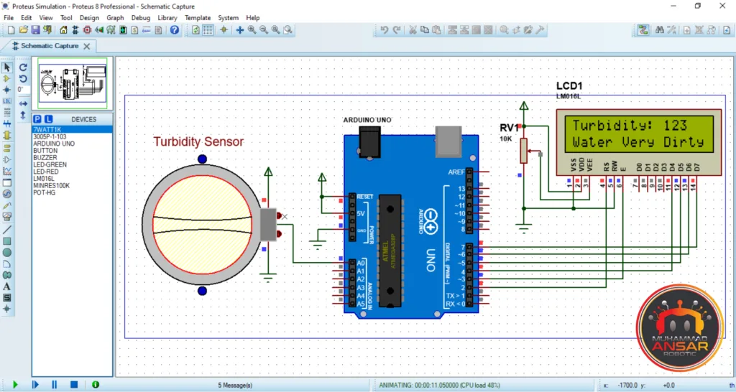
A conceptual diagram

Slide 8
Design and Prototyping Process
Title: Design & Prototyping Process
Research (Weeks 1–2)
Studied water quality parameters and existing monitoring solutions.
Selected affordable, reliable sensors compatible with Arduino.
Brainstorming & Initial Design (Weeks 3–4)
Conceptualized system architecture and power options.
Developed initial wiring and data handling configurations.

Slide 9
Prototyping & Testing (Weeks 5–8)
Built the first prototype, assembled sensors, and tested in sample water.
Validated sensor accuracy and improved calibration.
Iteration & Refinement (Weeks 9–10)
Optimized sensor placement and added GSM for remote alerts.
Created a basic web interface for data visualization.
Final Design & Documentation (Weeks 11–12)
Finalized assembly, documented specs, and prepared a user guide.

Slide 10
Technical Details
Title: “Sensors, Data Collection”
Content: Hardware Components
1)Solderless breadboard -1
2)16×2 LCD display – 1
3)Hard Jumper Wire 1 meter
4)5 PC 100R / 100 Ohm Resistance-1
5)10k Variable Resistor – 10k Potentiometer
6)Arduino Uno-1
7)Male to Male Jumper Wires-10
8)Turbidity Sensor Module-1
9)Male to Female jumper Wires-10
Software
Development Environment: Arduino IDE
Programming Language: C/C++
.

Slide 11
Roles and Responsibilities
Title: Roles & Responsibilities 1. Sirisha
Role: Kept the project on track and made sure we met deadlines.
Contributions: Organized tasks, coordinated between hardware and software, and ensured everything came together smoothly.
2.Navya
Role: Set up all the sensors and other hardware components.
Contributions: Chose and calibrated sensors, assembled the setup, and tested everything to ensure accuracy.

Slide 12
3. Divya Reddy
Role: Programmed the Arduino and managed data handling.
Contributions: Wrote code to capture, store, and send sensor data; set up GSM for remote alerts.
4. Likitha
Role: Handled data analysis and designed the online dashboard.
Contributions: Created alerts for unsafe water levels and designed a user-friendly dashboard to display water quality data.
5. Gowthami
Role: Documented the process and tested each feature.
Contributions: Wrote guides, organized testing, and made sure every component worked as planned.
Each of us contributed uniquely, combining our skills to develop a system that’s accurate, reliable, and user-friendly.

Slide 13
Budget and Resources
Title: Budget & Resources
1)Solderless breadboard -1-280rs
2)16×2 LCD display - 1-400rs
3)Hard Jumper Wire 1 meter-90rs
4)5 PC 100R / 100 Ohm Resistance-1-10rs
5)10k Variable Resistor – 10k Potentiometer-30rs
6)Arduino Uno-1-2100rs
7)Male to Male Jumper Wires-10-180rs
8)Turbidity Sensor Module-1-2200
9)Male to Female jumper Wires-10-180rs
For Large Prototype 3K-4K Rs

Slide 14
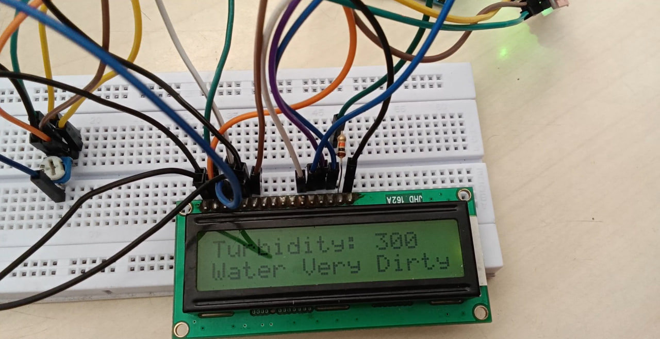
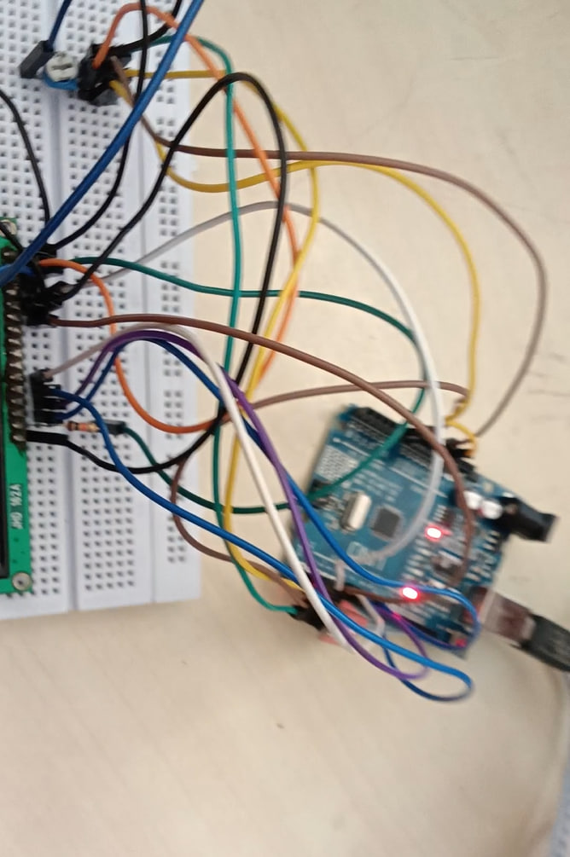
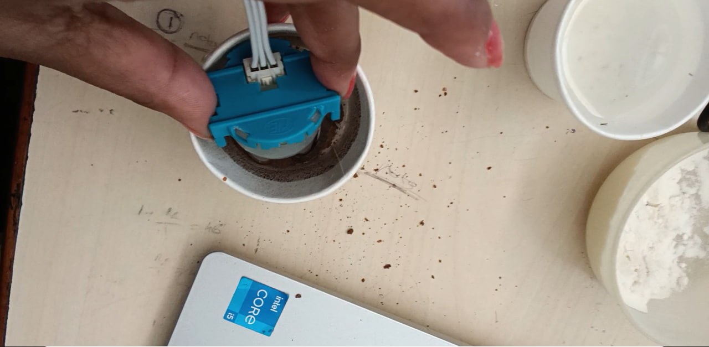
Prototype Demonstration
Title: "Validation"
Content:

Slide 15
Testing and Results
Title: Testing confirmed accurate water quality readings, stable data transmission, and efficient power use, demonstrating reliability for field applications.
Content: The prototype met objectives with accurate measurements and ease of use, though sensor reliability needs improvement.

Slide 16
Community Impact
Title: Community Impact
Unsafe drinking water, health issues, impact of environmental sustainability and water pollution.
Users: Homeowners and environmental advocates benefit by ensuring safe drinking water, reducing health risks, and supporting sustainable practices

Slide 17
Anticipated Impact:
Improved Health and Safety: Early detection of contaminants prevents health risks associated with polluted water, especially in areas reliant on local water bodies for drinking or agriculture.
2.Environmental Awareness: The project raises community awareness about water pollution, prompting more sustainable behaviors and local conservation efforts.
3.Informed Decision-Making: Real-time data supports local authorities in making data-driven decisions for water management, including rapid responses to contamination events.

Slide 18
Future Improvements and Next Steps
Title: Future Improvements & Next Steps
Next Steps : To take this project further, you can also consider interfacing a pH meter with Arduino and also read the pH value of water to better assess the quality of water.
Future Improvements : Uses artificial intelligence to forecast potential water quality issues.

Slide 19
Reflection and Learning
Title: Reflection & Learning
Technical: Sensor calibration, data management, IoT, and machine learning.
Interpersonal: Team collaboration, time management, problem-solving, documentation.
Skills Gained: Data analytics, programming, project management, and communication.

Slide 20


